Slide 1
ATAI
Advanced Technique of Artificial Intelligence
ATAI
ChongqingUniversity _{AdvancedTechniqueof}
of Technology Artificial Intelligence
Chongqing University of
Technology
Chongqing University ^{ATAI}
_{of Technology} Advanced Techniqueof
Artificial Intelligence
Chongqing University of Technology
Chongqing University of Technology
Multi-Modal Sarcasm Detection Based on Dual Generative Processes
Code : None
—— IJCAI’2024
Reported by Yang Jiang
1

Slide 2
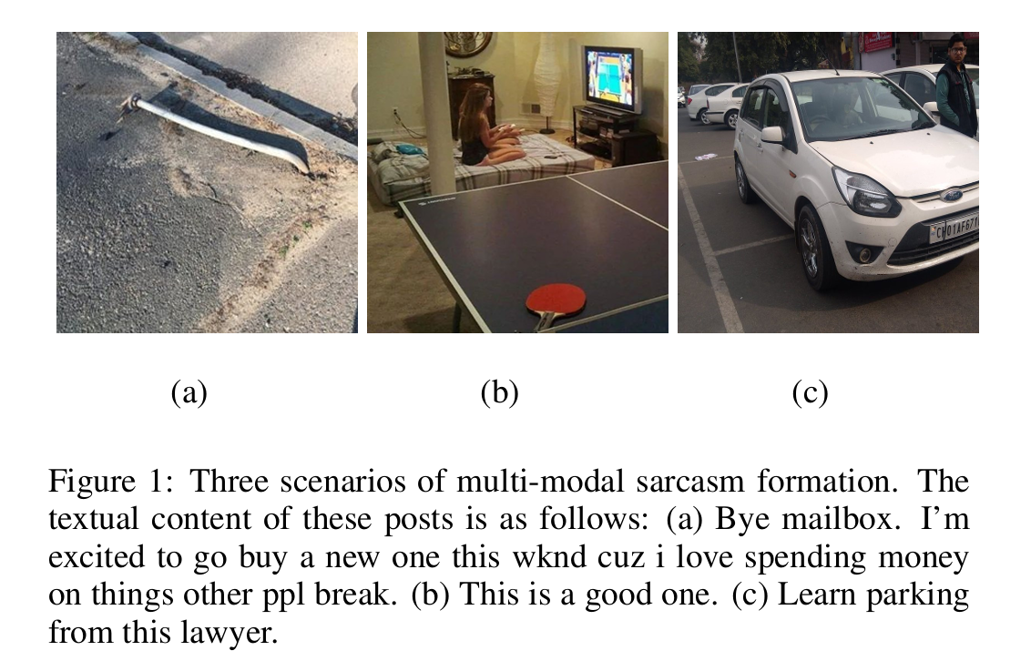
ATAI
Advanced Technique of Artificial Intelligence
ATAI
ChongqingUniversity _{AdvancedTechniqueof}
of Technology Artificial Intelligence
Chongqing University of
Technology
Chongqing University ^{ATAI}
_{of Technology} Advanced Techniqueof
Artificial Intelligence
Chongqing University of Technology
Chongqing University of Technology
Introduction
Often, there is ample information to identify sarcasm from just one modality, yet existing research typically assumes that both modalities’ features are necessary for sarcasm detection, potentially introducing bias in the information fusion process.

Slide 3
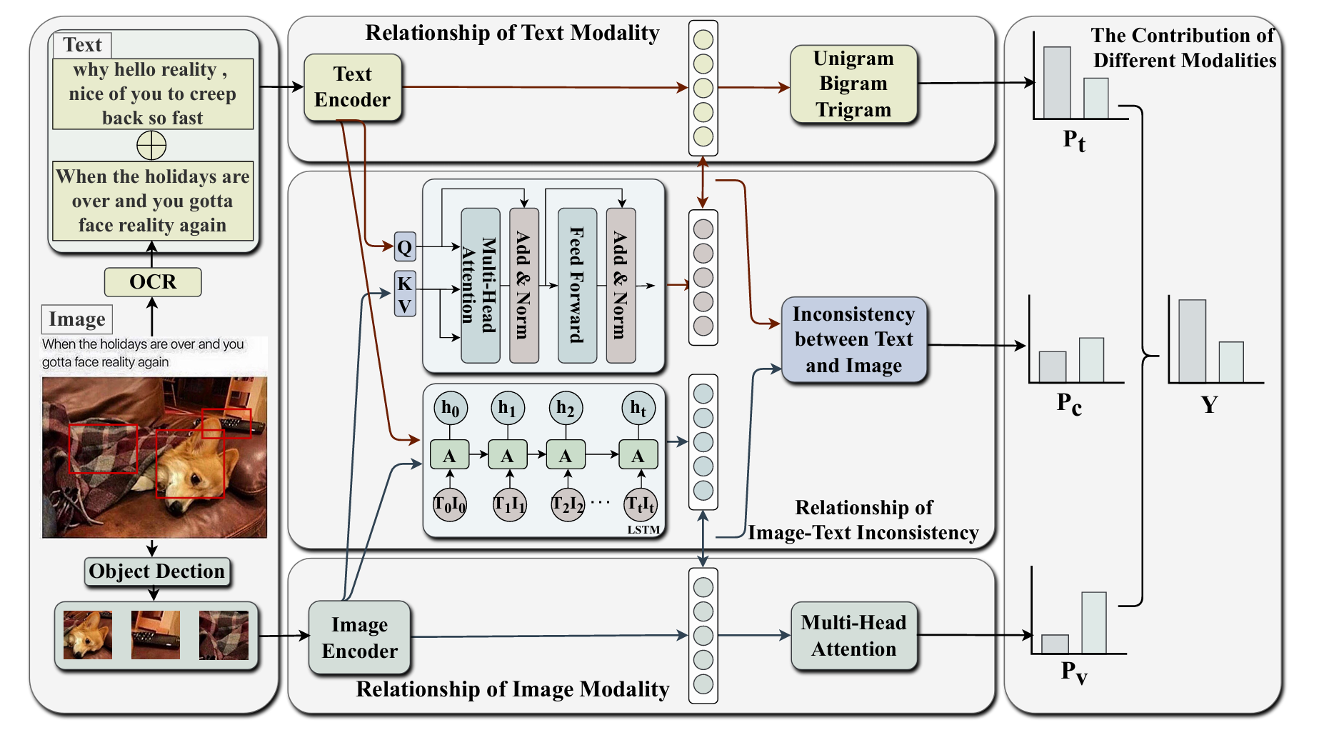
ATAI
Advanced Technique of Artificial Intelligence
ATAI
ChongqingUniversity _{AdvancedTechniqueof}
of Technology Artificial Intelligence
Chongqing University of
Technology
Chongqing University ^{ATAI}
_{of Technology} Advanced Techniqueof
Artificial Intelligence
Chongqing University of Technology
Chongqing University of Technology
Overview

Slide 4
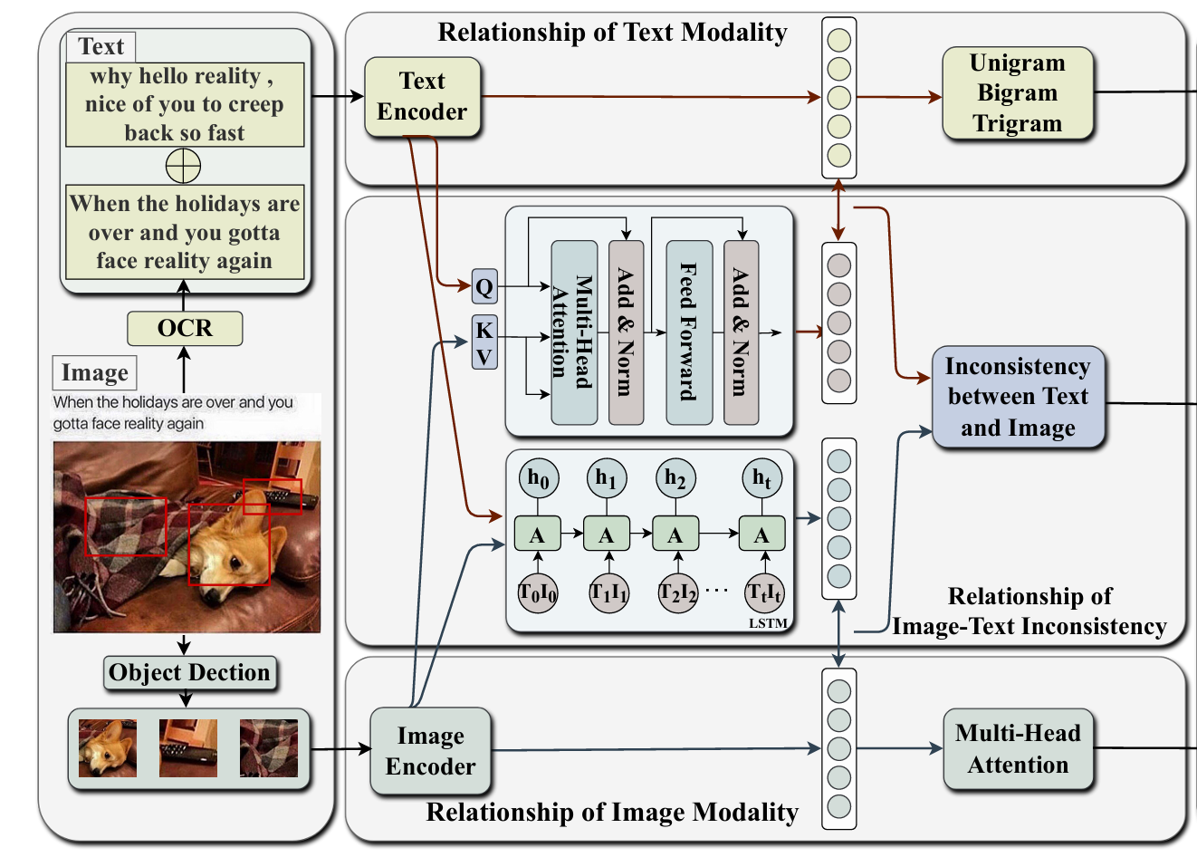
ATAI
Advanced Technique of Artificial Intelligence
ATAI
ChongqingUniversity _{AdvancedTechniqueof}
of Technology Artificial Intelligence
Chongqing University of
Technology
Chongqing University ^{ATAI}
_{of Technology} Advanced Techniqueof
Artificial Intelligence
Chongqing University of Technology
Chongqing University of Technology
Method

Slide 5
ATAI
Advanced Technique of Artificial Intelligence
ATAI
ChongqingUniversity _{AdvancedTechniqueof}
of Technology Artificial Intelligence
Chongqing University of
Technology
Chongqing University ^{ATAI}
_{of Technology} Advanced Techniqueof
Artificial Intelligence
Chongqing University of Technology
Chongqing University of Technology
Method

Slide 6
ATAI
Advanced Technique of Artificial Intelligence
ATAI
ChongqingUniversity _{AdvancedTechniqueof}
of Technology Artificial Intelligence
Chongqing University of
Technology
Chongqing University ^{ATAI}
_{of Technology} Advanced Techniqueof
Artificial Intelligence
Chongqing University of Technology
Chongqing University of Technology
Method

Slide 7
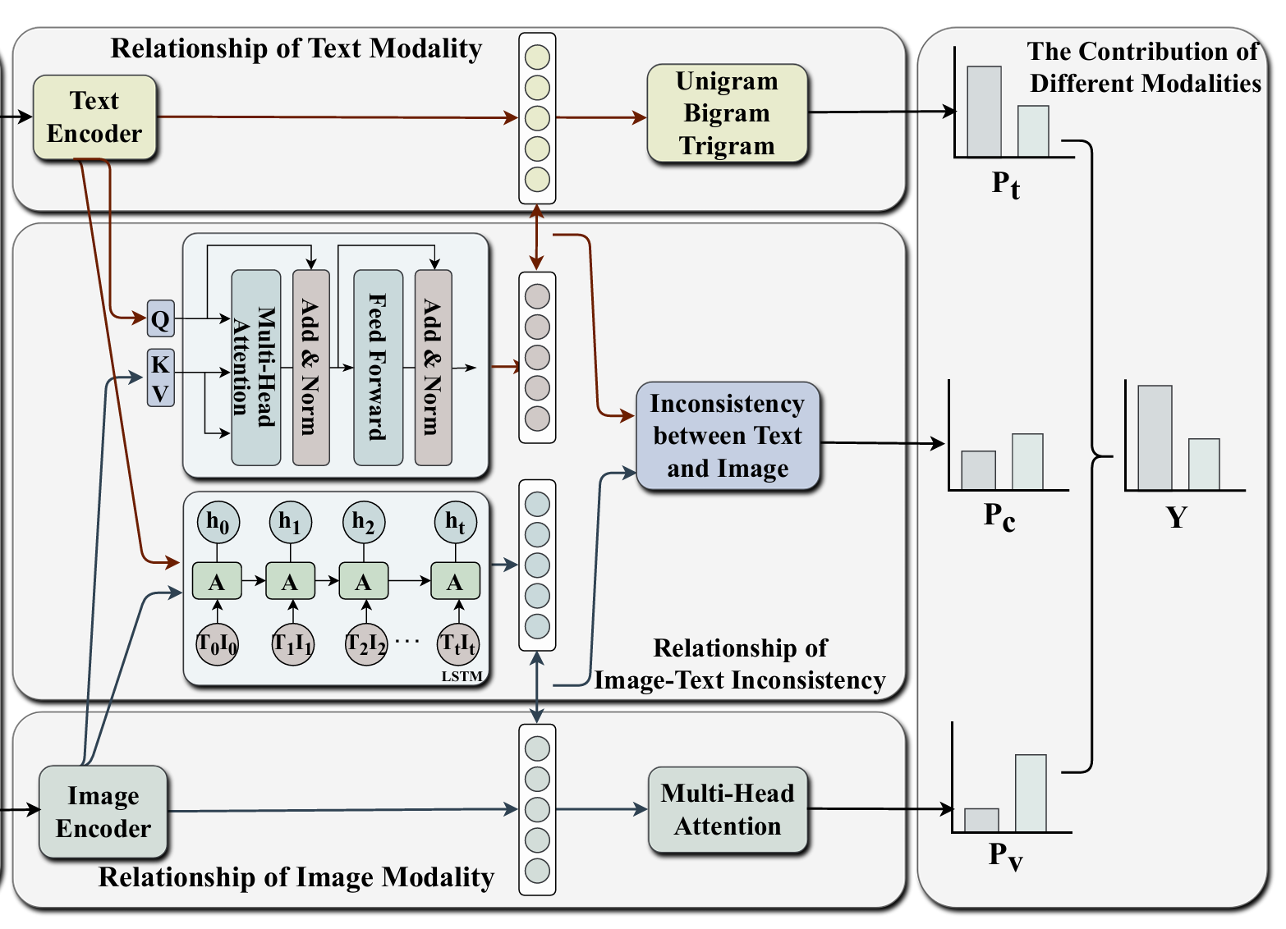
ATAI
Advanced Technique of Artificial Intelligence
ATAI
ChongqingUniversity _{AdvancedTechniqueof}
of Technology Artificial Intelligence
Chongqing University of
Technology
Chongqing University ^{ATAI}
_{of Technology} Advanced Techniqueof
Artificial Intelligence
Chongqing University of Technology
Chongqing University of Technology
Method

Slide 8
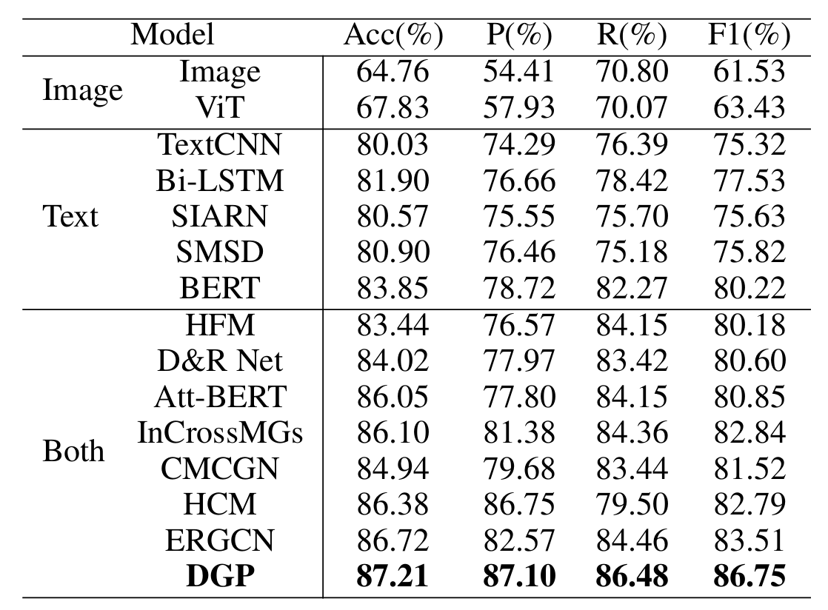
ATAI
Advanced Technique of Artificial Intelligence
ATAI
ChongqingUniversity _{AdvancedTechniqueof}
of Technology Artificial Intelligence
Chongqing University of
Technology
Chongqing University ^{ATAI}
_{of Technology} Advanced Techniqueof
Artificial Intelligence
Chongqing University of Technology
Chongqing University of Technology
Experiments

Slide 9
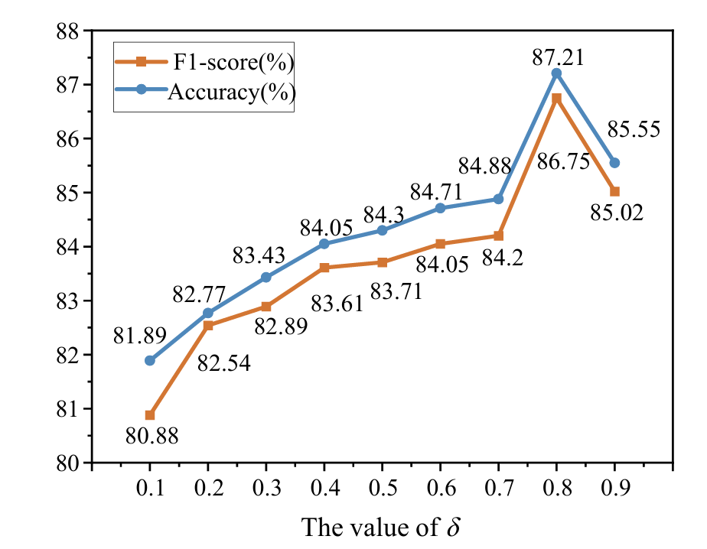
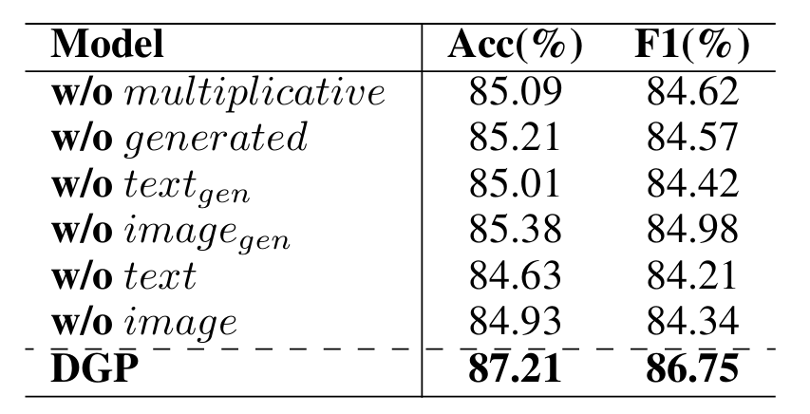
ATAI
Advanced Technique of Artificial Intelligence
ATAI
ChongqingUniversity _{AdvancedTechniqueof}
of Technology Artificial Intelligence
Chongqing University of
Technology
Chongqing University ^{ATAI}
_{of Technology} Advanced Techniqueof
Artificial Intelligence
Chongqing University of Technology
Chongqing University of Technology
Experiments

Slide 10
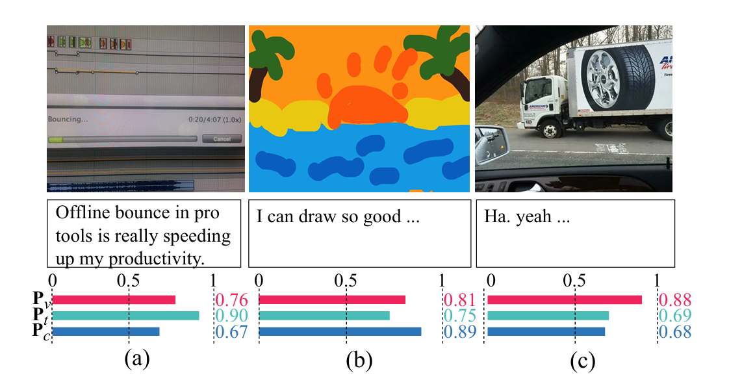
ATAI
Advanced Technique of Artificial Intelligence
ATAI
ChongqingUniversity _{AdvancedTechniqueof}
of Technology Artificial Intelligence
Chongqing University of
Technology
Chongqing University ^{ATAI}
_{of Technology} Advanced Techniqueof
Artificial Intelligence
Chongqing University of Technology
Chongqing University of Technology
Experiments

Slide 11
ATAI
Advanced Technique of Artificial Intelligence
ATAI
ChongqingUniversity _{AdvancedTechniqueof}
of Technology Artificial Intelligence
Chongqing University of
Technology
Chongqing University ^{ATAI}
_{of Technology} Advanced Techniqueof
Artificial Intelligence
Chongqing University of Technology
Chongqing University of Technology
Thanks!

